Slide 1
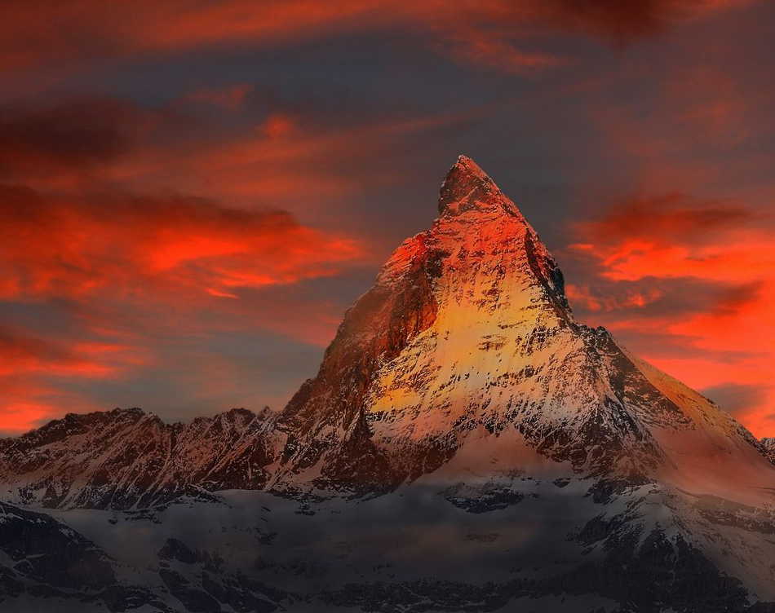
Hymn of Heaven

Slide 2
C Csus C
How I long to breathe the air of Heaven
Am F G
Where pain is gone and mercy fills the streets
C F C G Am
To look upon the one who bled to save me
F G C Csus C
And walk with Him for all eternity

Slide 3
C F G C
Oh, There will be a day When all will bow before Him
C F Am G
There will be a day When death will be no more
C F G C G Am
Standing face to face With He who died and rose again
F G C
Holy holy is the Lord

Slide 4
C F C
Every prayer we prayed in desperation
Am F G
The songs of faith we sang through doubt and fear
C F C G Am
In the end we’ll see that it was worth it
F G C Csus C
When He returns to wipe away our tears

Slide 5
C F G C
Oh, There will be a day When all will bow before Him
C F Am G
There will be a day When death will be no more
C F G C G Am
Standing face to face With He who died and rose again
F G C
Holy holy is the Lord

Slide 6
C F C
On that day we join the resurrection
Am F G
And stand beside the heroes of the faith
C F C G Am
With one voice a thousand generations
F G C
Sing “worthy is the Lamb who was slain”

Slide 7
C F C
On that day we join the resurrection
Am F G
And stand beside the heroes of the faith
C F C G Am
With one voice a thousand generations
F G C
Sing “worthy is the Lamb who was slain”
F G C Csus C
“Forever He shall reign”

Slide 8
C F G C
So let it be today we shout the hymn of Heaven
C F Am G
With angels and the Saints we raise a mighty roar
C F G C G Am
“Glory to our God” who gave us life beyond the grave
F G C
Holy holy is the Lord

Slide 9
C F G C
So let it be today we shout the hymn of Heaven
C F Am G
With angels and the Saints we raise a mighty roar
C F G C G Am
“Glory to our God” who gave us life beyond the grave
F G Am
Holy holy is the Lord
F G Am
Holy holy is the Lord
F G C Csus C
Holy holy is the Lord

